Slide 1
COMP220: SOFTWARE DEVELOPMENT TOOLS
COMP285: COMPUTER AIDED SOFTWARE DEVELOPMENT
Sebastian Coope
coopes@liverpool.ac.uk
www.csc.liv.ac.uk/~coopes/comp220/
www.csc.liv.ac.uk/~coopes/comp285/
COMP 285/220
© University of Liverpool
slide <number>
Notes:
<Program Title>

Slide 2
Bug management tools
Record and store bugs/feature requests
Controls reporting
Controls bug lifecycle
  Open … → Closed
Provides notifications
  Get email on bug status change
Gives project management oversight
  e.g. What bugs at what level outstanding
Controls accountability
  Who must do what when
COMP220
© University of Liverpool
slide <number>

Slide 3
Aspects of a bug
Product/Component
  A product can be made up of several components
    (UI, security layer, database layer)
Status
  Open, closed
Resolution
  FIXED, INVALID, DUPLICATE, WONTFIX, WORKSFORME
COMP319
© University of Liverpool
slide <number>

Slide 4
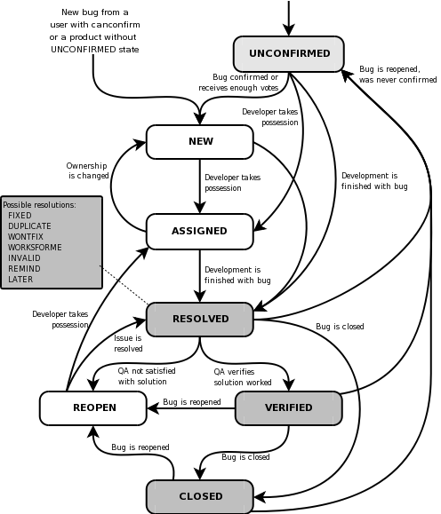
Bug lifecycle
COMP319
© University of Liverpool
slide <number>

Slide 5
UNCONFIRMED
This bug has recently been added to the database. Nobody has validated that this bug is true. Users who have the "canconfirm" permission set may confirm this bug, changing its state to NEW. Or, it may be directly resolved and marked RESOLVED.
COMP319
© University of Liverpool
slide <number>
Notes:
<Program Title>

Slide 6
CONFIRMED
This bug has recently been added to the assignee's list of bugs and must be processed. Bugs in this state may be accepted, and become ASSIGNED, passed on to someone else, and remain NEW, or resolved and marked
COMP319
© University of Liverpool
slide <number>

Slide 7
ASSIGNED (IN_PROGRESS)
This bug is not yet resolved, but is assigned to the proper person. From here bugs can be given to another person and become NEW, or resolved and become RESOLVED.
COMP319
© University of Liverpool
slide <number>
Notes:
<Program Title>

Slide 8
RESOLVED
FIXED Code fix checked in
INVALID Not a bug
WONTFIX Not important to fix
DUPLICATE Same as another bug
WORKSFORME Cannot reproduce
INCOMPLETE Not enough information
COMP319
© University of Liverpool
slide <number>

Slide 9
Verified
QA has looked at the bug and the resolution and agrees that the appropriate resolution has been taken. Any zombie bugs who choose to walk the earth again must do so by becoming REOPENED
COMP319
© University of Liverpool
slide <number>

Slide 10

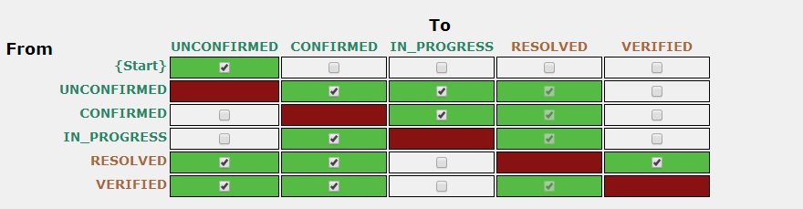
Controlling the work flow
COMP319
© University of Liverpool
slide <number>

Slide 11
Importance
Priority
  How importance is this to fix
Severity
  What is the bugs impact
Not the same thing
  Low severity bug which is high priority (needed for immediate release)
  High severity bug which is low priority (obsolete component)
COMP319
© University of Liverpool
slide <number>

Slide 12
Bug information
Platform and OS
  Android, Windows, Chrome (may include version)
Version
  Product release version
Reporter
  Who reported bug
CC list
  Who gets notified about bug changes
COMP319
© University of Liverpool
slide <number>

Slide 13
Bug information
Target
  Which version will the bug fix be released on
Attachments
  Often used for screen dumps of bug
COMP319
© University of Liverpool
slide <number>

Slide 14
Other features
Watches
  Useful if developer’s on holiday
  Track bug handling for new developers
Time tracking
  How long do we spend on a bug
  Set deadlines for bugs
COMP319
© University of Liverpool
slide <number>

Slide 15
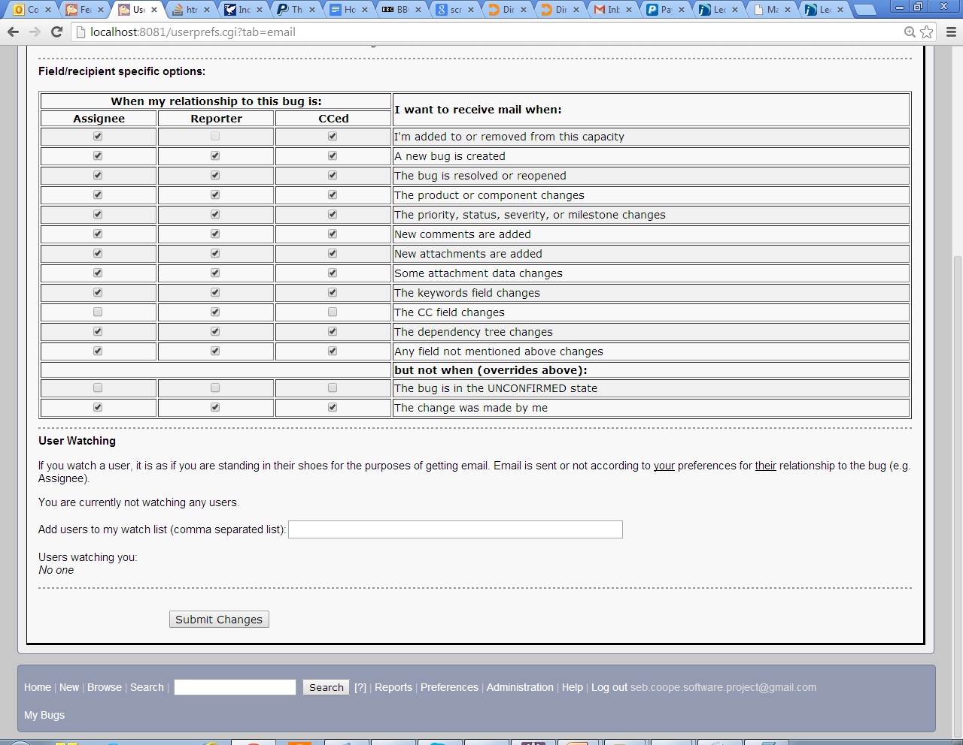
Notifications
COMP319
© University of Liverpool
slide <number>
Notes:
<Program Title>

Slide 16
Summary
Bug management tools provide
  Structured gathering of information
  Structured reported of information
  Structured lifecycle for debugging and Q&A
  Clear view of current product quality
  Reporting of bugs and bugs status via email
COMP319
© University of Liverpool
slide <number>

